Slide 1



PLANETARY TOURISM
001
BY- GALAXIAGEEKS
SHRUTIKA BAGUL
ARYAN GHATGE
SHRADDHA DHAKAD
RAJ MANE
SMIT JOSHI
NIKITA CHOUDHARI

Slide 2

INTRODUCTION
PROBLEM STATEMENT
The Planetary Tourism Office is a pioneering venture that extends the boundaries of adventure and exploration beyond our home planet.
This office is dedicated to facilitating safe, informative, and thrilling space travel experiences for the intrepid souls seeking to explore worlds beyond Earth.
Develop a planetary tourism office to implement travelling of tourists to different planets.
GALAXIAGEEKS
002

Slide 3

009
Inspired by the growing interest in space exploration, we envisioned a digital platform to ignite public enthusiasm for interplanetary adventures by recognising the need for accessible information and trip planning. We embarked on creating a user friendly web app for Seamless Planetary Tourism experience
MOTIVATION
GALAXIAGEEKS

Slide 4

003
OBJECTIVES
promote space tourism awareness
ensure safety and reliability
ensure affordability and accessibility
Create unforgettable customer experiences
promote user friendly interaction with the environment
GALAXIAGEEKS

Slide 5





007
TECH STACK !

Slide 6

006
FUTURE SCOPE
Virtual reality space tourism
interstellar travel possibilities
space based gaming and competitions
space archaeology expeditions
space related volunteer programs
GALAXIAGEEKS

Slide 7
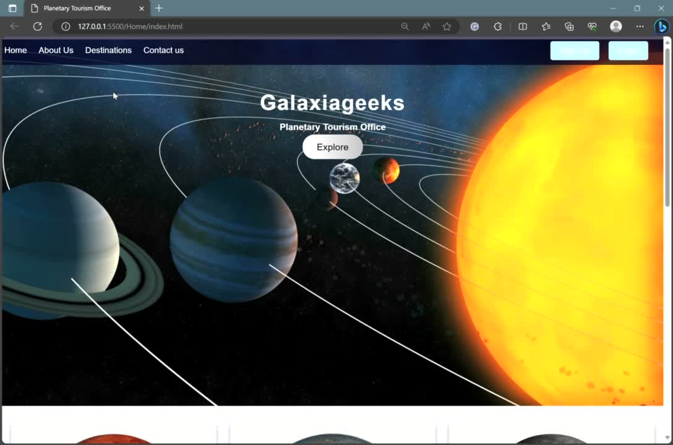
GALAXIAGEEKS

